Slide 1
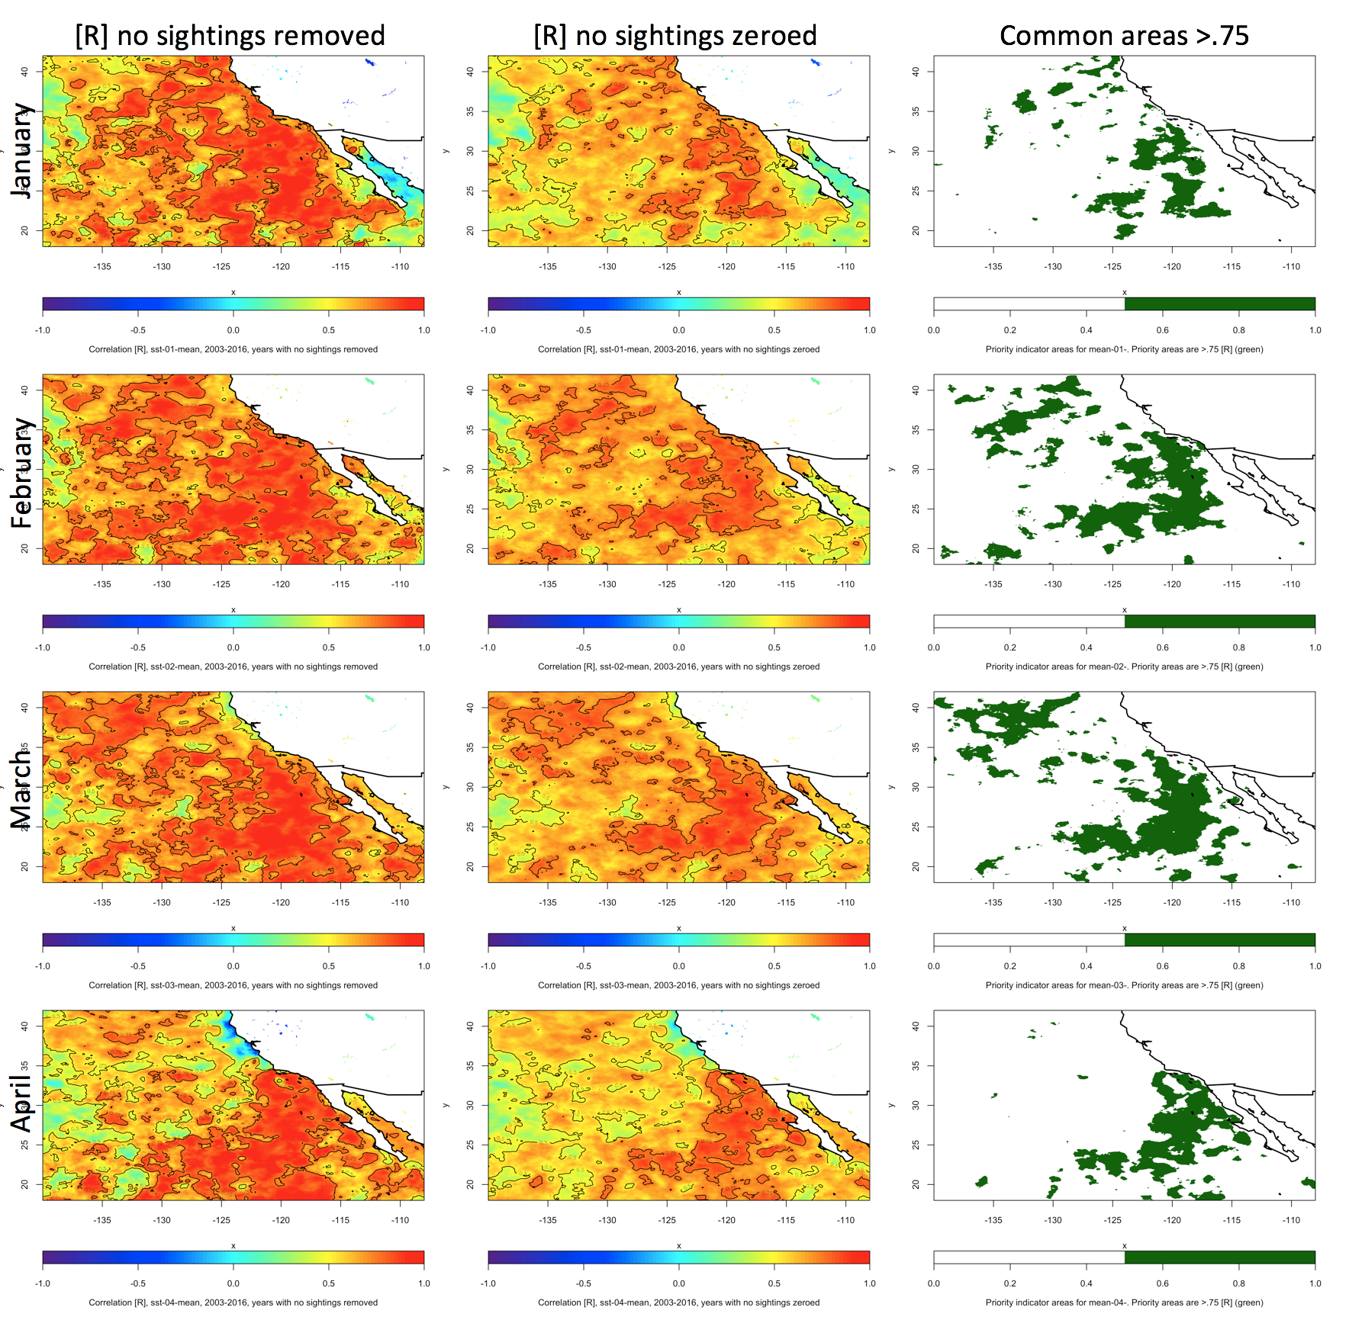

Slide 2
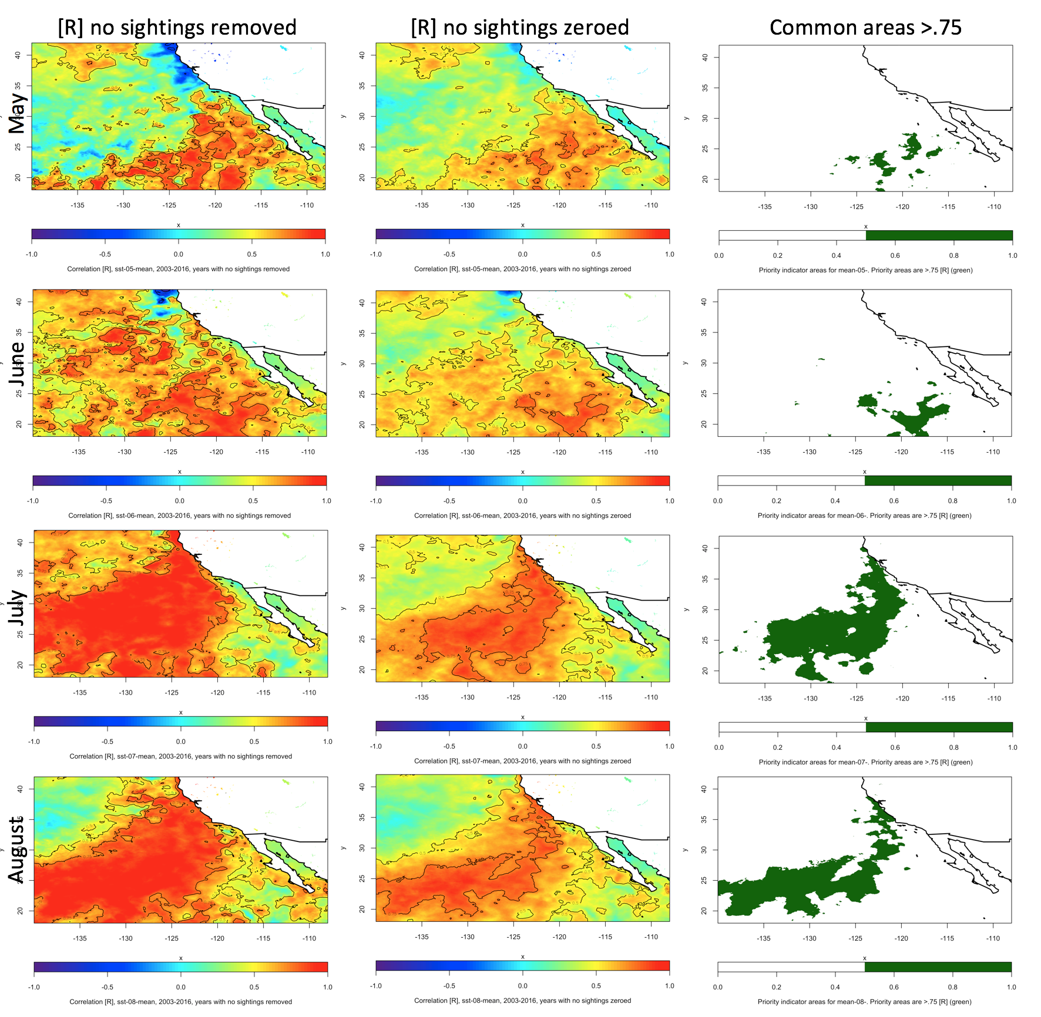

Slide 4
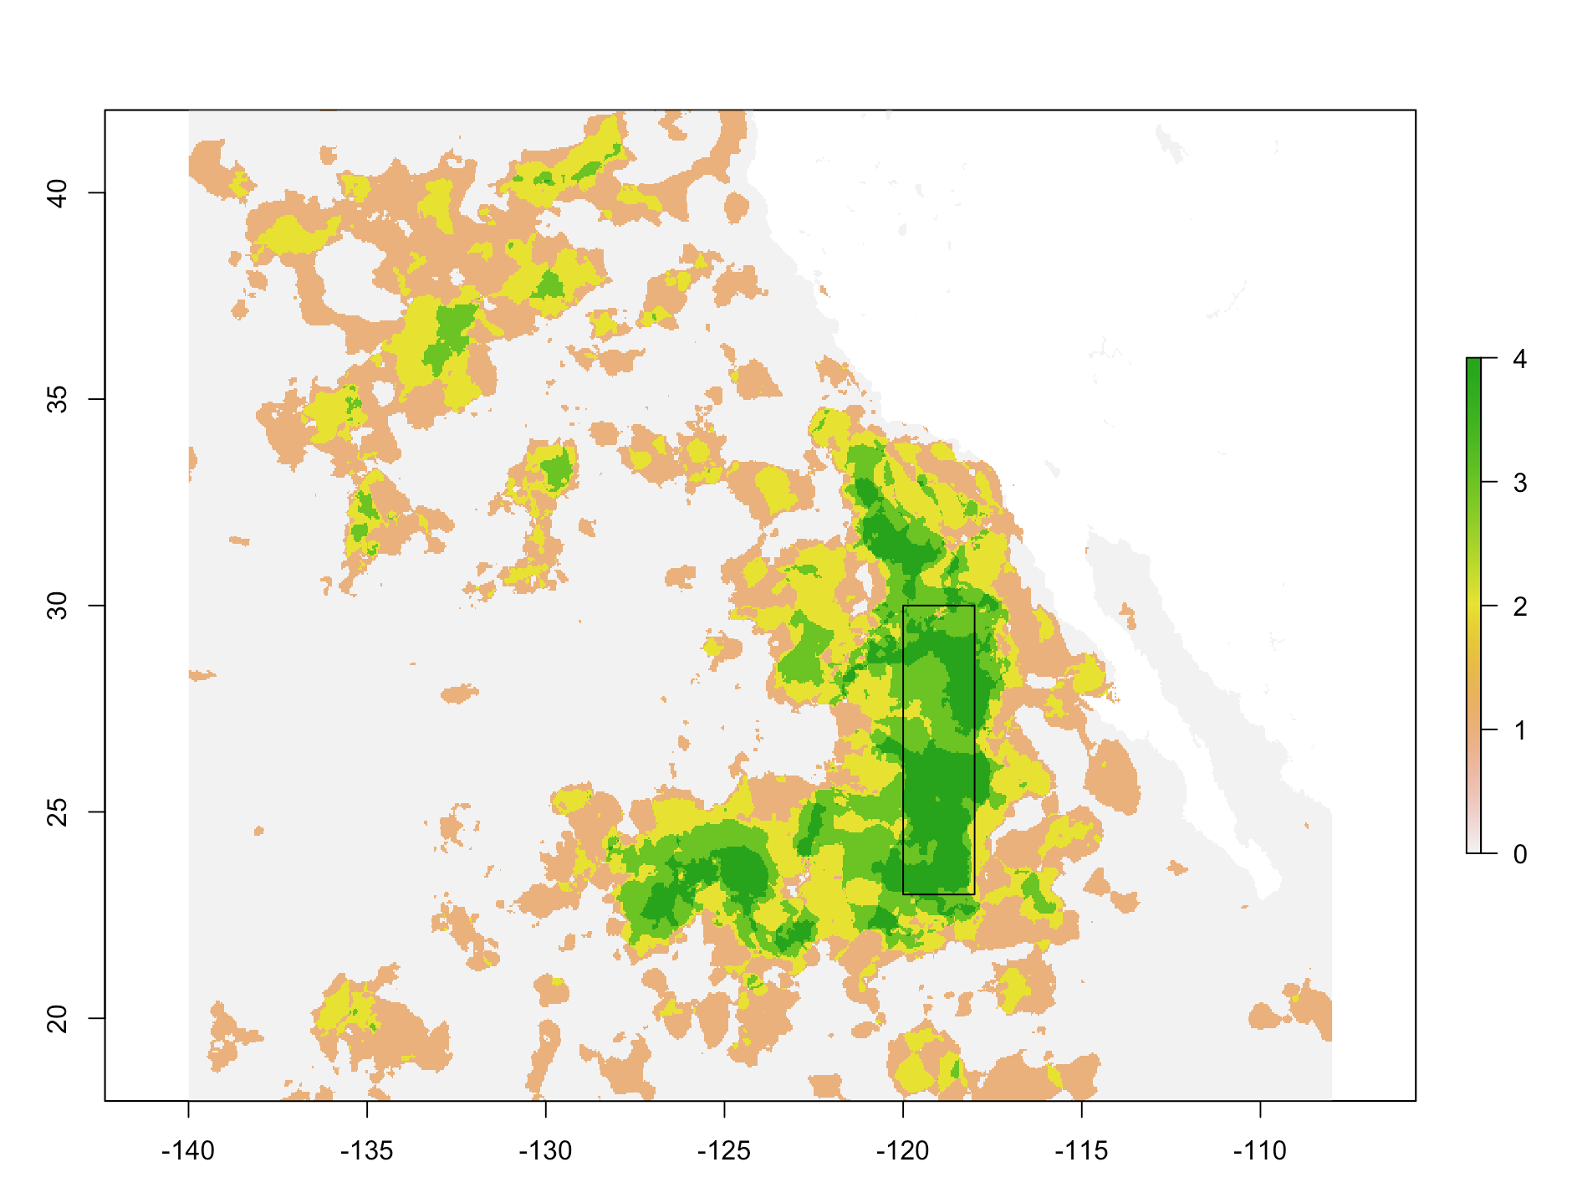
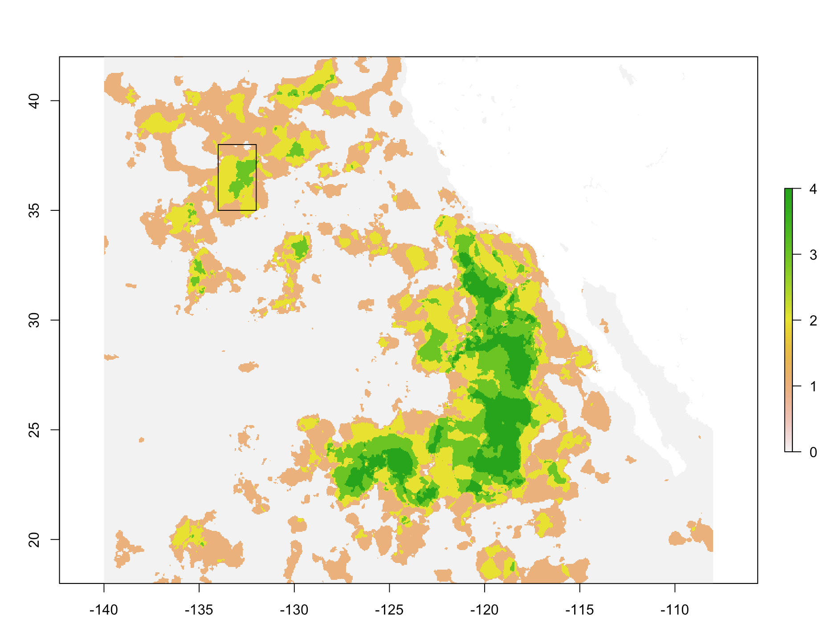
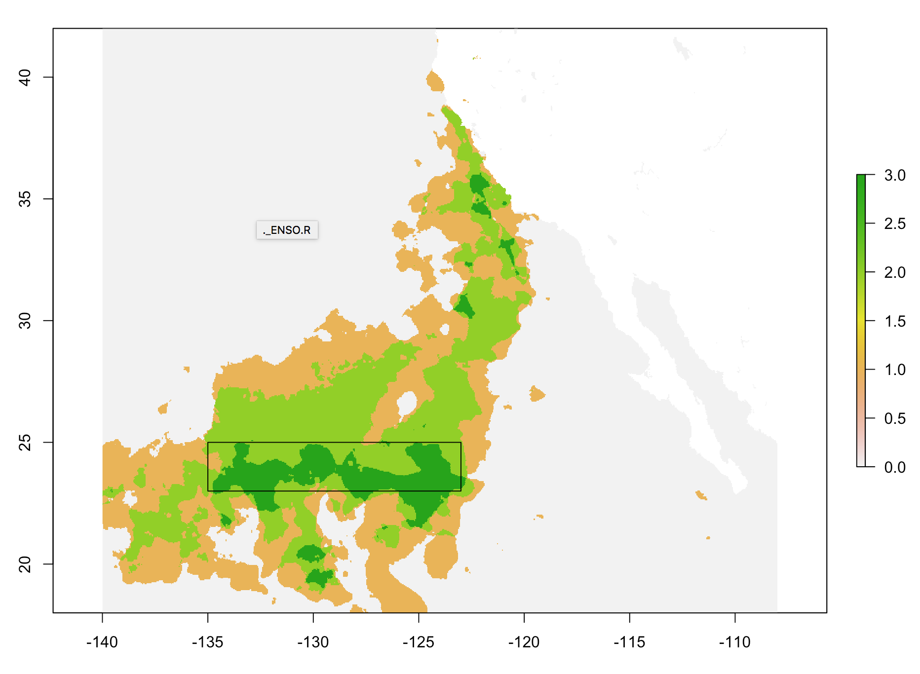
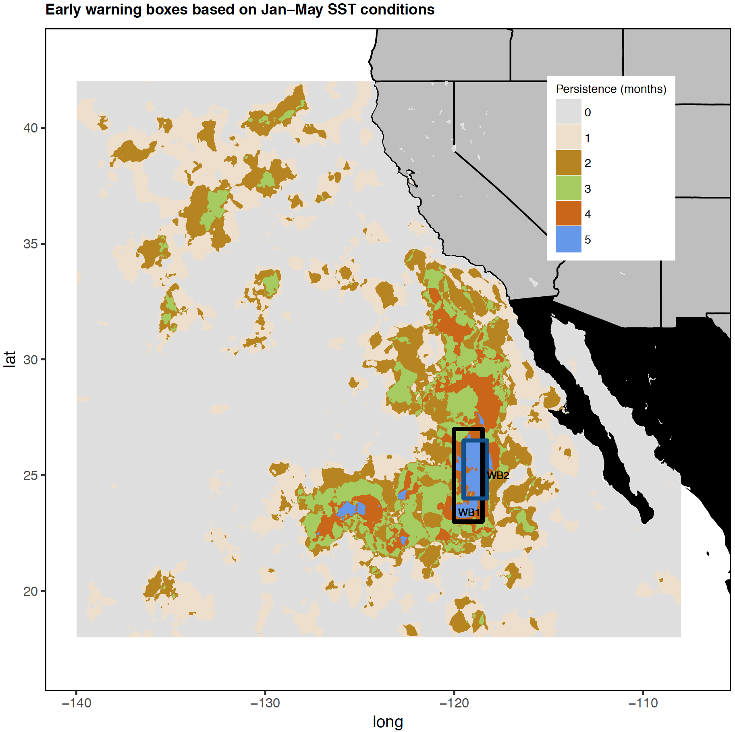
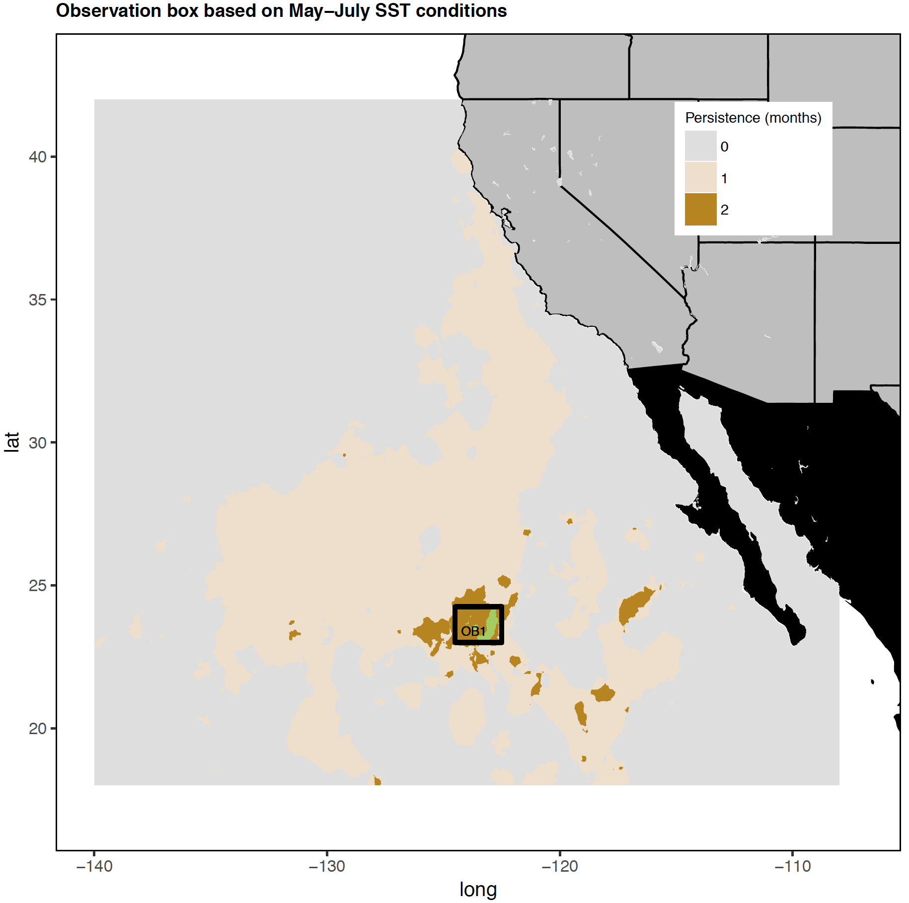
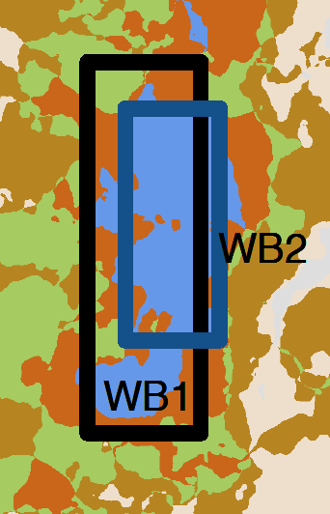
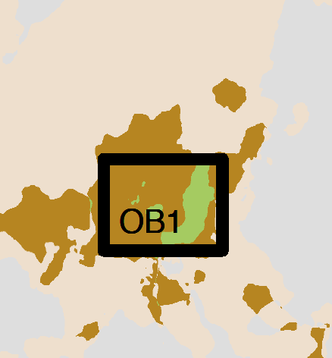
Creating an SST box, 3 options from previous call:
Box name: JFMA1
Based off: Jan, Feb, Mar, Apr
Correlation threshold: >.75
Box name: JFMA2
Based off: Jan, Feb, Mar, Apr
Correlation threshold: >.75
Box name: JAS1
Based off: Jul, Aug, Sep
Correlation threshold: >.75
Last call we discussed developing ‘warning’ and ‘observational’ boxes (WB and OB):

Slide 5
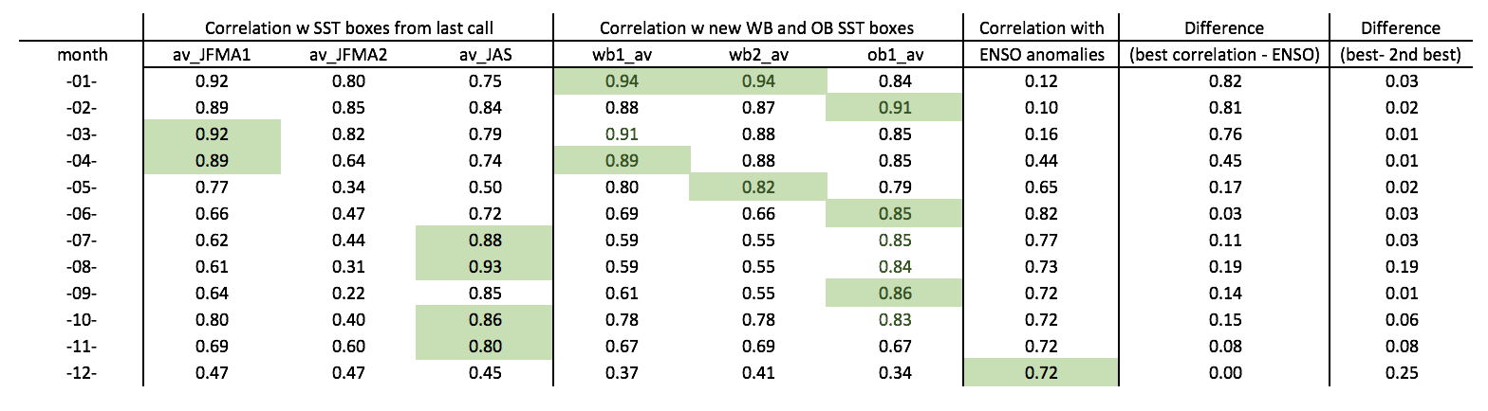
Comparison with ENSO index
• Green cells have the highest correlations with turtle sightings for each given month
• Correlation values are averaged across both methods of handling years with no turtle sightings
Take home points:
JFMA2 is not worth considering
JFMA1 is also probably not worth considering (cor only .01 higher than next best box in March and April)
WB2 probably not useful, only higher than WB1 in one month by .02, and best to not over restrict box area
Would recommend using JAS, WB1, ENSO, and possibly OB1 (not much additional information in the latter)
Next steps:
After we’ve reached agreement on box dimensions, I will move forward with several rule options and a hindcast analysis to test the potential frequency of closures and alignment of closures with historically high turtle years
Take home points:
JFMA2 is not worth considering
JFMA1 is also probably not worth considering (cor only .01 higher than next best box in March and April)
WB2 probably not useful, only higher than WB1 in one month by .02, and best to not over restrict box area
Would recommend using JAS, WB1, ENSO, and possibly OB1 (not much additional information in the latter)

